Slide 1

POWER BI ENABLED CROP PRODUCTION ANALYSIS
NAME : EBONICA SALETH
AICTE STUDENT ID :STU649030f34dcf31687171315

Slide 2

PROBLEM STATEMENT
Agriculture plays a crucial role in the economy of many countries, including India. However, the agricultural sector faces various challenges, including unpredictable weather patterns, pest attacks, and market fluctuations. To address these challenges effectively, stakeholders require insightful analysis and actionable insights based on agricultural data.
The problem at hand is to utilize Power BI to enable crop production analysis for agricultural stakeholders in India. The dataset provided contains information about crop production in different states and districts of India over multiple years. The objective is to build a comprehensive Power BI solution that allows users to:
Visualize Crop Production Trends: Provide visualizations that depict the trends in crop production over time, allowing users to identify patterns and fluctuations.
Identify High-Yield Regions: Enable users to identify regions (states/districts) with consistently high crop production and understand the factors contributing to their success.
Seasonal Analysis: Analyze crop production based on seasonal variations (e.g., Rabi, Kharif, Whole Year) to understand seasonal dependencies and optimize agricultural practices accordingly.

Slide 3
Project Description
Overview:
The project aims to leverage Power BI to conduct comprehensive analysis and visualization of crop production data in India. The dataset provided contains information on crop production in various states and districts across different crop years. By utilizing Power BI's versatile features, the project will enable stakeholders to gain valuable insights into crop production trends, identify high-yield regions, analyze seasonal variations, and make data-driven decisions to optimize agricultural practices.
Key Components:
Data Preparation:
Import the provided dataset into Power BI and perform necessary data cleaning and preprocessing steps to ensure data accuracy and consistency.
Create relationships between different data tables if required for analysis.
Dashboard Design:
Design an interactive dashboard within Power BI comprising various visualizations to facilitate data exploration and analysis.
Organize the dashboard layout in a user-friendly manner, allowing stakeholders to navigate seamlessly between different sections.

Slide 4
Visualizations:
Card: Display key metrics such as sum of production using card visuals for quick insights.
Pie Chart: Illustrate the distribution of crop production across different crops or states using pie charts, allowing stakeholders to identify dominant crops or regions.
Stacked Bar Chart: Compare area across different districts using stacked bar charts, enabling stakeholders to understand production trends.
Waterfall Chart: Analyze the factors contributing to changes in crop production over time using waterfall charts, highlighting areas of improvement or decline.
Funnel Chart: Funnel chart is to identify potential inefficiencies or bottlenecks in the crop production process by visualizing the transformation of cultivated area into actual crop yield.
Stacked Area Chart: Show the cumulative production of major crops over time using stacked area charts, depicting overall production trends.
Line and Stacked Column Chart: Compare the production of specific crops across different seasons or years using line and stacked column charts, enabling stakeholders to assess seasonal variations.
Area Chart: Plot the trend of total crop production over the years using area charts, allowing stakeholders to observe long-term production trends.
Gauge: Display key performance indicators such as yield per hectare or production efficiency using gauge visuals, providing a quick overview of performance metrics.

Slide 5
User Interaction:
Enable stakeholders to interact with the dashboard dynamically by providing filters and slicers to explore specific regions, crops, or time periods.
Implement drill-down capabilities to allow users to delve deeper into the data and extract granular insights.
By developing this Power BI-enabled crop production analysis solution, stakeholders in the agricultural sector will gain valuable insights into production trends, identify areas for optimization, and make informed decisions to enhance agricultural productivity and sustainability. The interactive nature of the dashboard will empower users to explore data intuitively and derive actionable insights, ultimately contributing to the growth and development of the agricultural industry in India.

Slide 6

WHO ARE THE END USERS?
Farmers:
Farmers form a crucial segment of the end users. They can utilize the Power BI-enabled crop production analysis to make informed decisions regarding crop selection, resource allocation, and cultivation practices based on historical production trends, seasonal variations, and regional performance metrics.
Farmers can benefit from insights into high-yield regions, optimal planting seasons, and crop-specific production patterns, enabling them to maximize their agricultural output and profitability.
Agricultural Extension Officers:
Agricultural extension officers responsible for providing advisory services to farmers can leverage the Power BI solution to disseminate actionable insights and best practices.
They can use the dashboard to identify regions or districts requiring intervention, offer targeted guidance on crop selection, pest management, and irrigation techniques, and monitor the effectiveness of agricultural interventions over time.
Policy Makers and Government Agencies:
Policy makers and government agencies involved in agricultural policy formulation and implementation can utilize the Power BI solution to inform evidence-based policy decisions.
They can analyze crop production trends at national, state, and district levels, identify regions requiring policy support or infrastructure development, and allocate resources effectively to enhance agricultural productivity and food security.
Agricultural Researchers:
Agricultural researchers and academicians can benefit from the Power BI-enabled analysis to conduct research on crop production patterns, agricultural economics, and sustainability.
They can use the dashboard to explore historical data, identify research gaps, and generate insights for scientific publications, policy recommendations, and agricultural innovation.

Slide 7
Agribusinesses and Market Analysts:
Agribusinesses, including seed companies, fertilizer manufacturers, and agricultural machinery suppliers, can leverage the Power BI solution to understand market demand and supply dynamics.
Market analysts can use the dashboard to analyze crop production trends, forecast market demand for specific crops, and identify potential investment opportunities or market niches within the agricultural sector.
NGOs and Development Organizations:
Non-governmental organizations (NGOs) and development organizations working in the agricultural domain can utilize the Power BI solution to design targeted interventions and development programs.
They can use the dashboard to assess the impact of ongoing projects, identify areas for capacity building or technology transfer, and track progress towards sustainable agricultural development goals.
The end users of the Power BI-enabled crop production analysis encompass a diverse range of stakeholders involved in agriculture, including farmers, extension officers, policy makers, researchers, agribusinesses, and development organizations. The solution caters to their varied needs by providing actionable insights, facilitating evidence-based decision-making, and fostering collaboration towards enhancing agricultural productivity and sustainability.

Slide 8

Technology Used
Power BI: Power BI serves as the core technology platform for developing the crop production analysis solution. It provides a suite of tools for data visualization, interactive reporting, and business intelligence analytics. Key features utilized include dashboard design, data modeling, visualizations, and integration with external data sources.
Microsoft Excel (or similar spreadsheet software): Microsoft Excel may be used for initial data preprocessing, cleaning, and formatting before importing the dataset into Power BI. Excel's data manipulation capabilities can help ensure data consistency and prepare it for analysis.
Python : It was used to create a Hexbin plot of crop production over the years.
The charts used in the project:
Card
Pie Chart
Stacked Bar Chart
Waterfall Chart
Funnel Chart
Stacked Area Chart
Line and Stacked Column Chart
Area Chart
Gauge

Slide 9
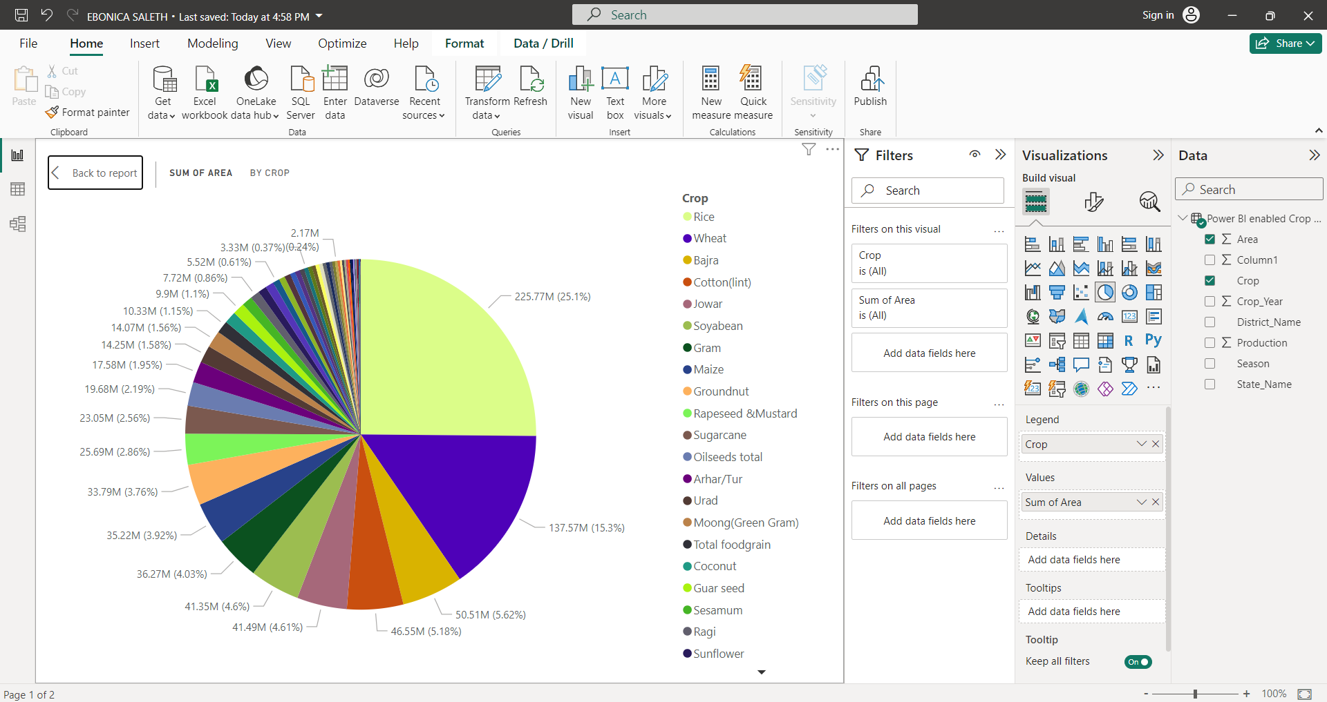
RESULTS
Demo Link

Slide 10
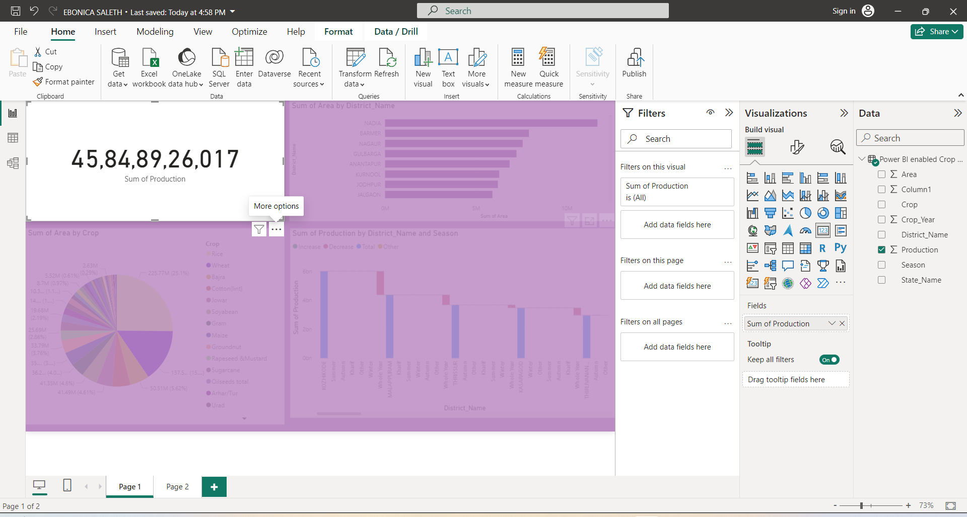
Demo Link

Slide 11
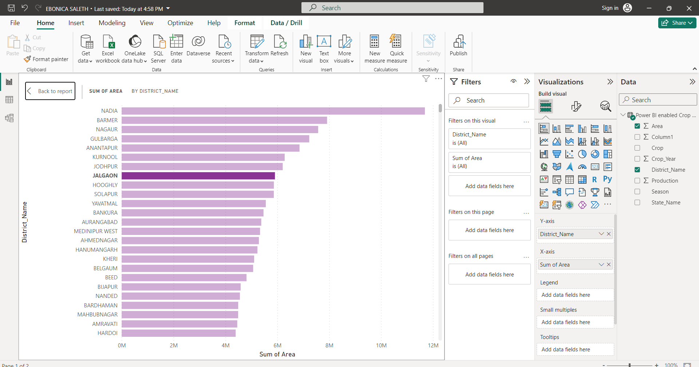
Demo Link

Slide 12
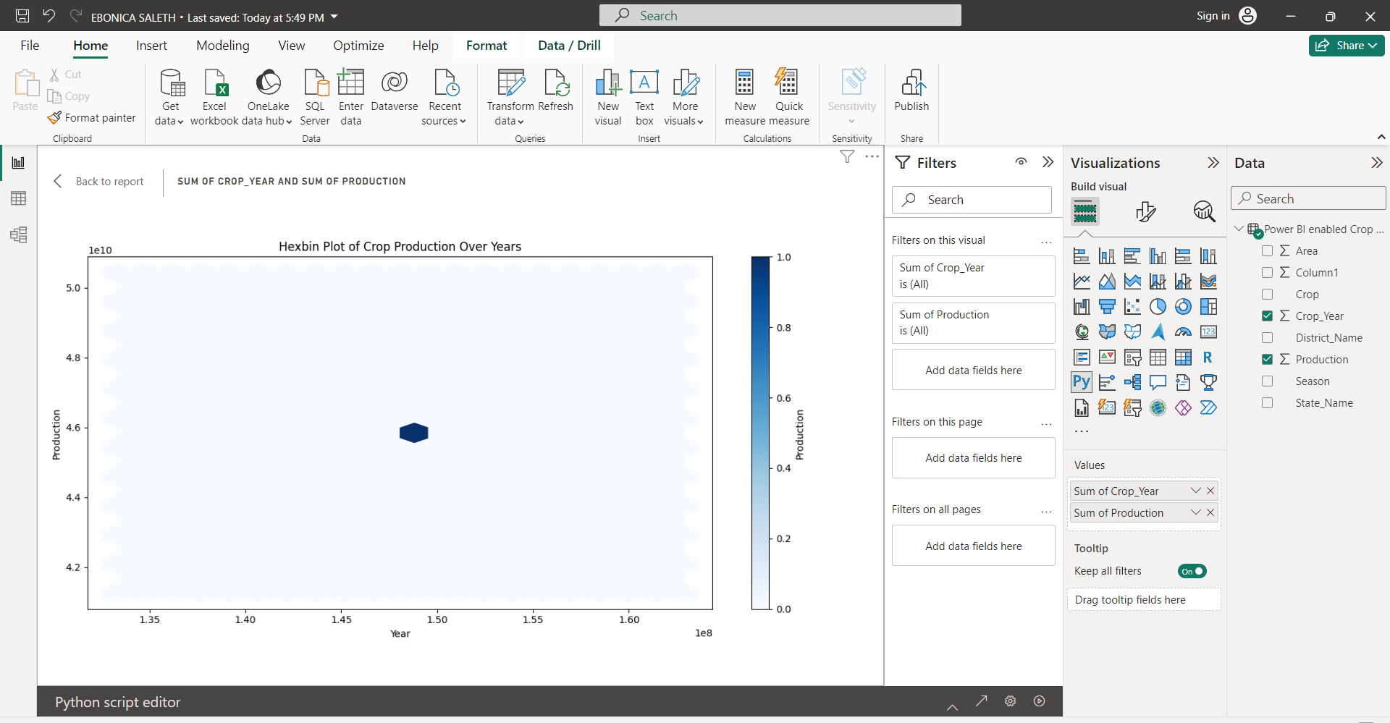
Demo Link

Slide 13
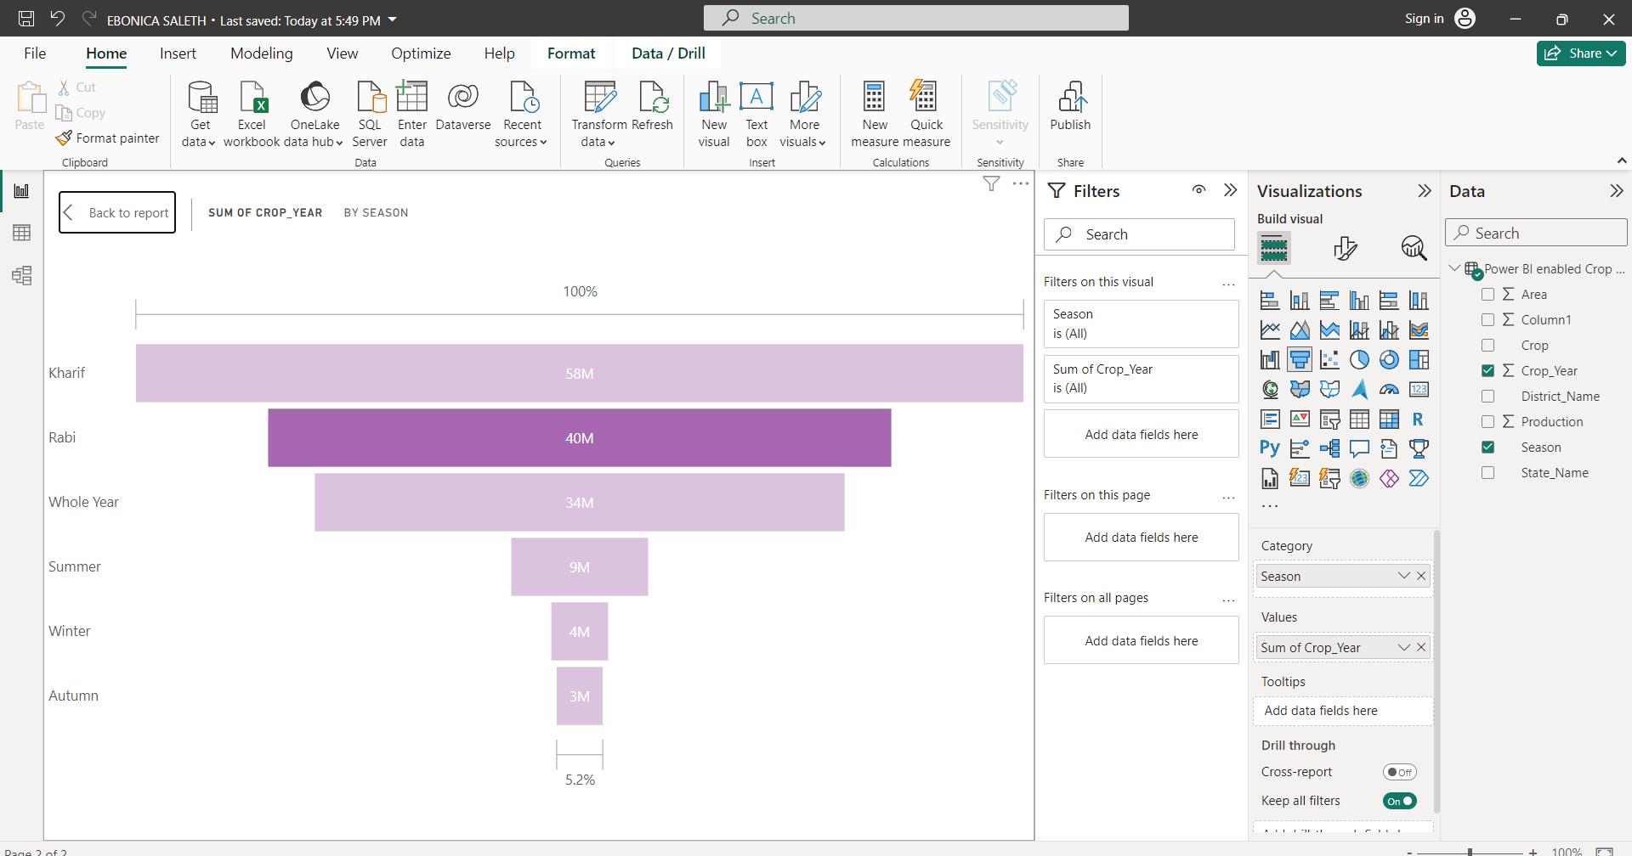
Demo Link

Slide 14
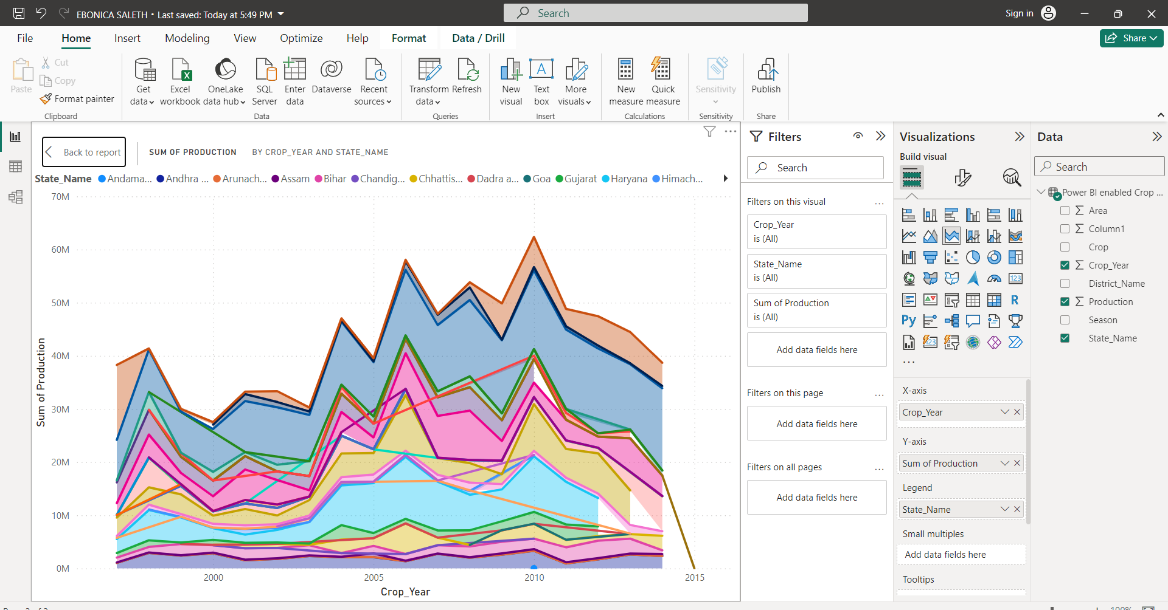
Demo Link

Slide 15
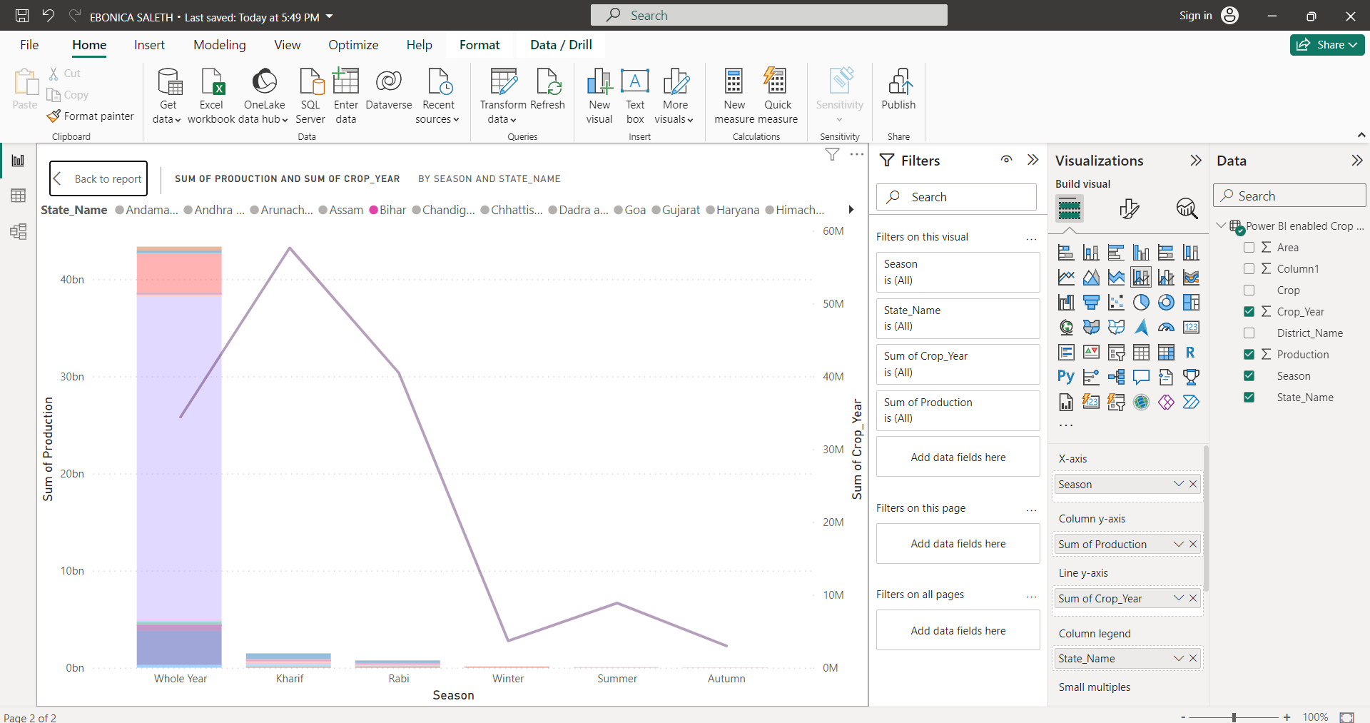
Demo Link

Slide 16
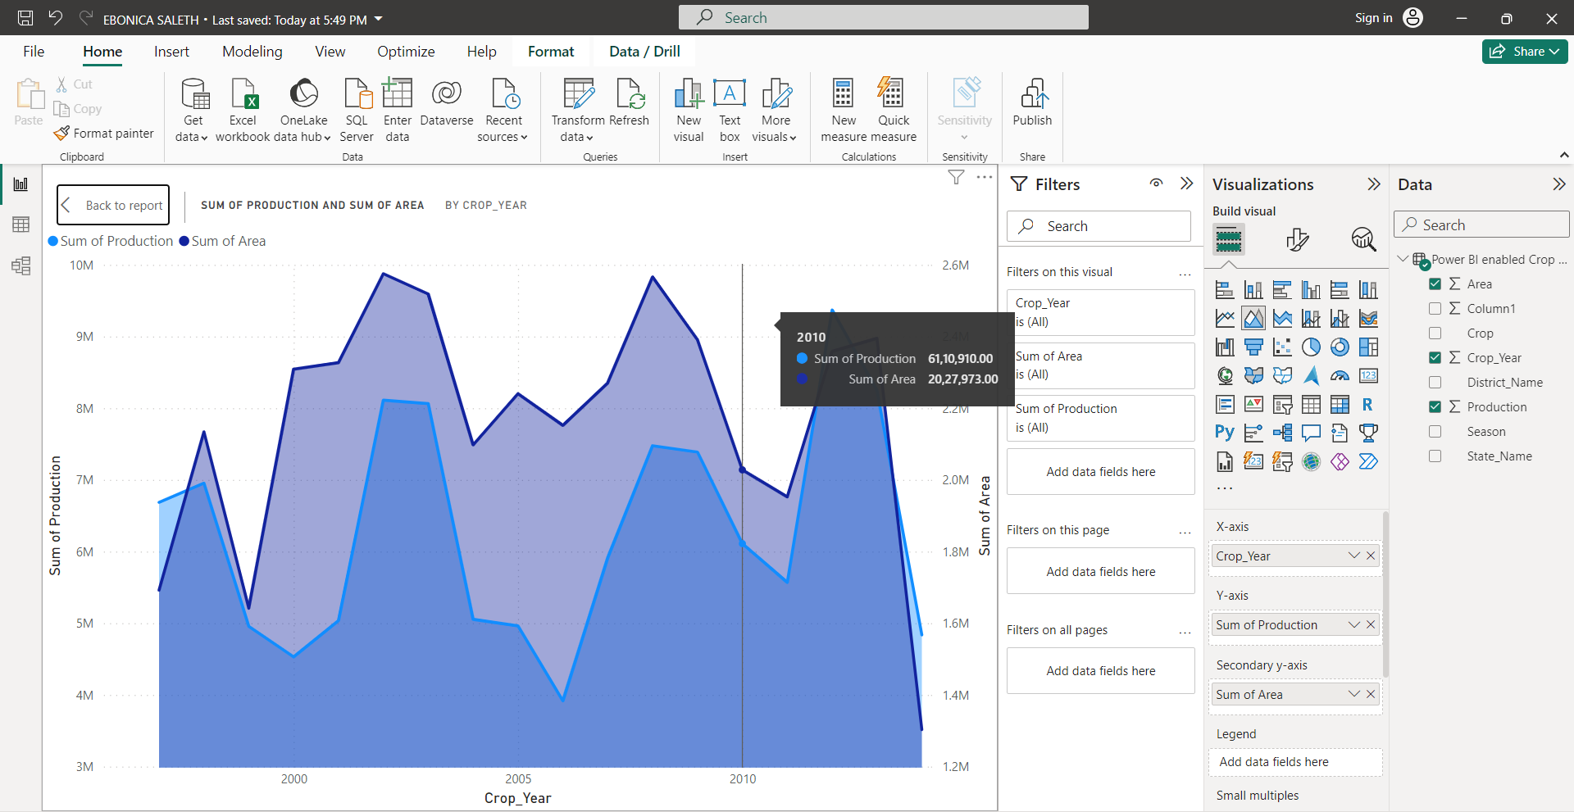
Demo Link

Slide 17
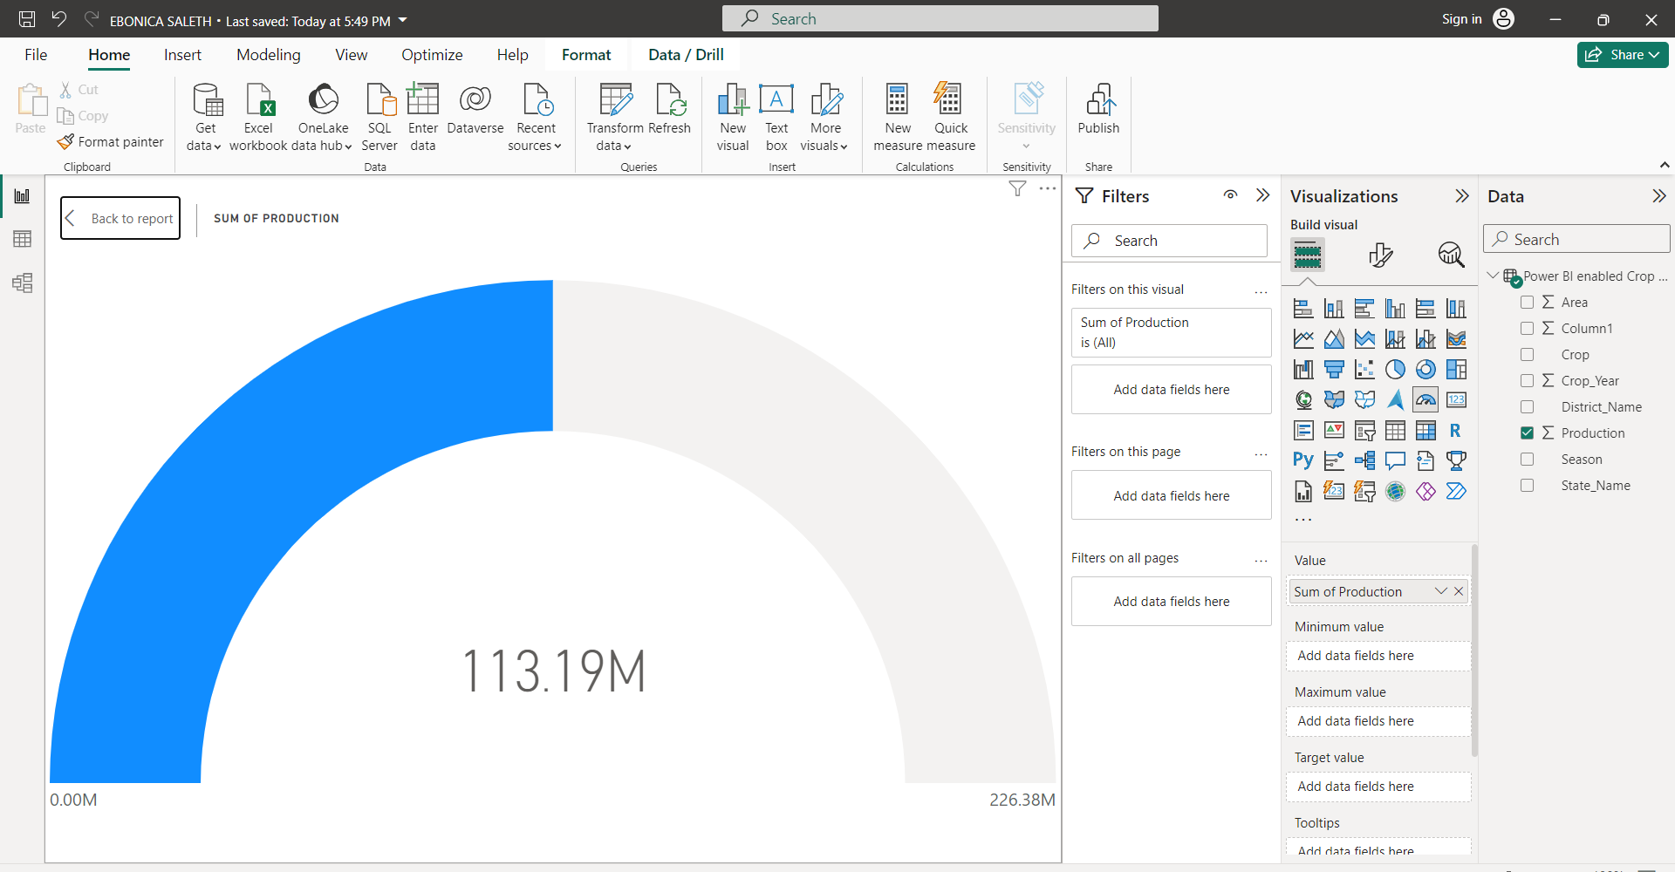
Demo Link

Slide 18
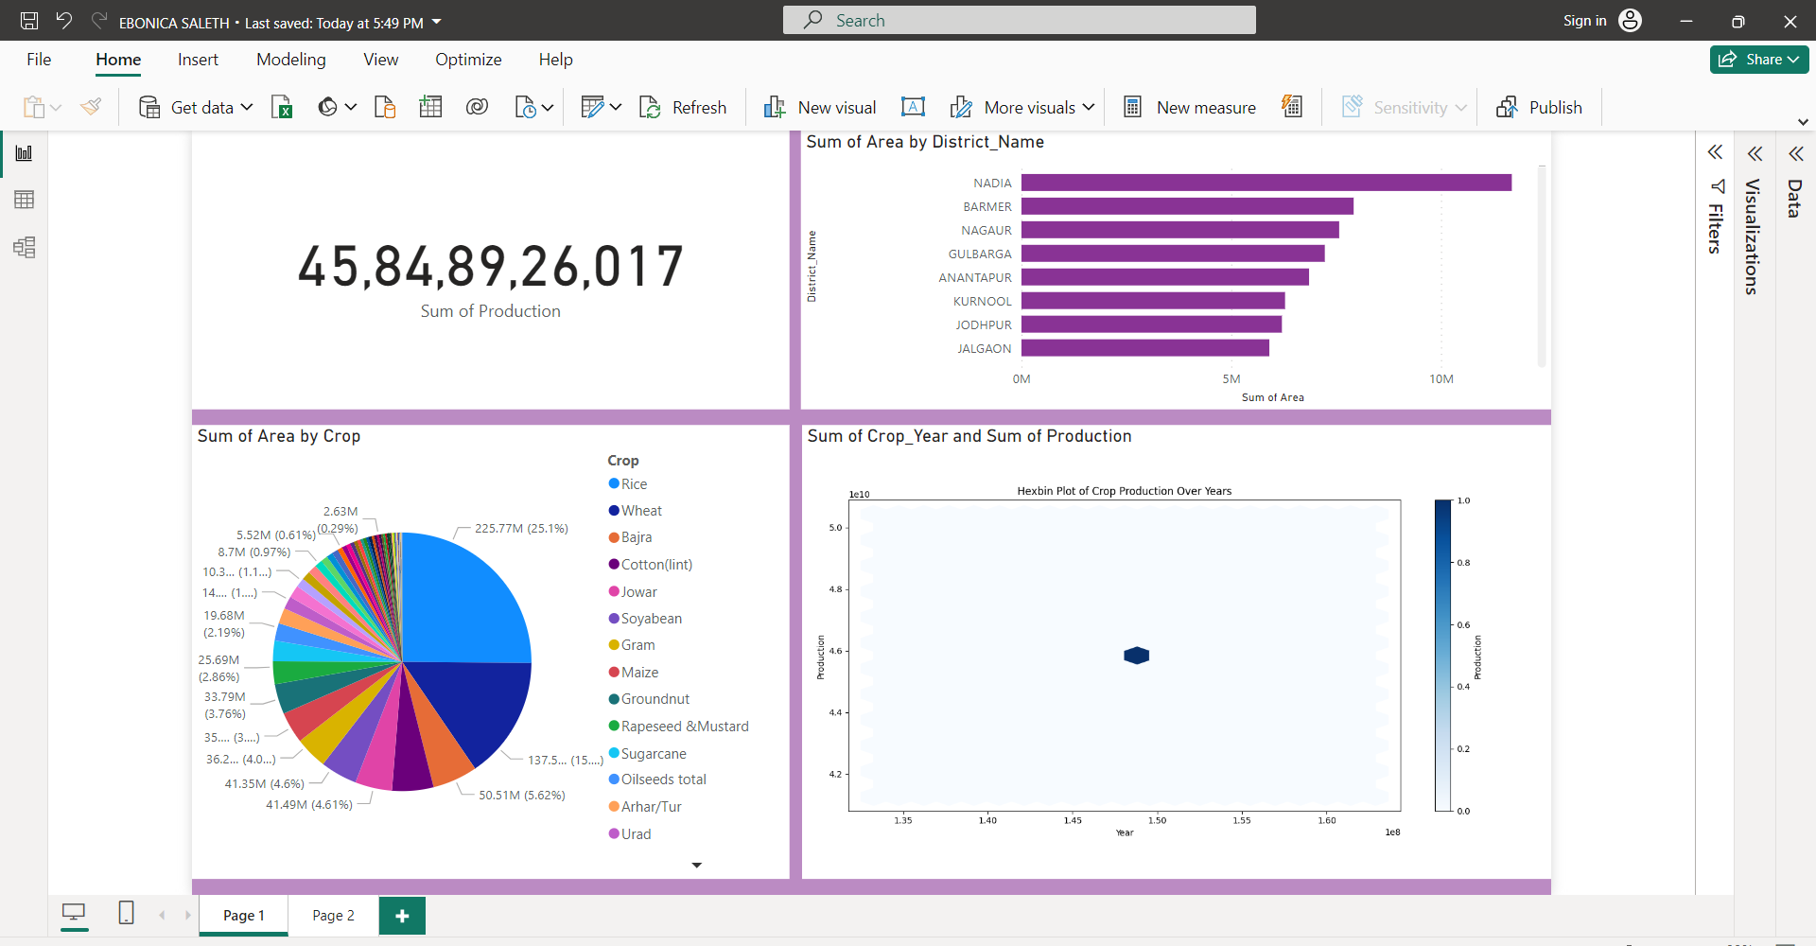
Demo Link

Slide 19
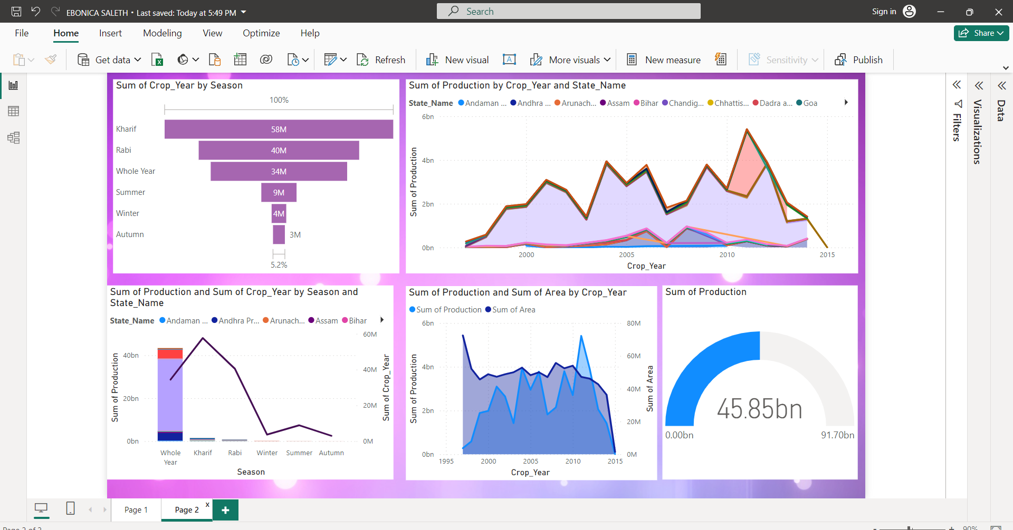
Demo Link

Slide 20
Thank you
In summary, the Power BI-enabled crop production analysis project provides stakeholders with insightful visualizations and analytical tools to understand crop production trends, identify high-yield regions, and anticipate seasonal variations. By leveraging data-driven insights, stakeholders can optimize agricultural practices, improve productivity, and contribute to the sustainable growth of the agricultural sector in India.
.
.

